Slide 1
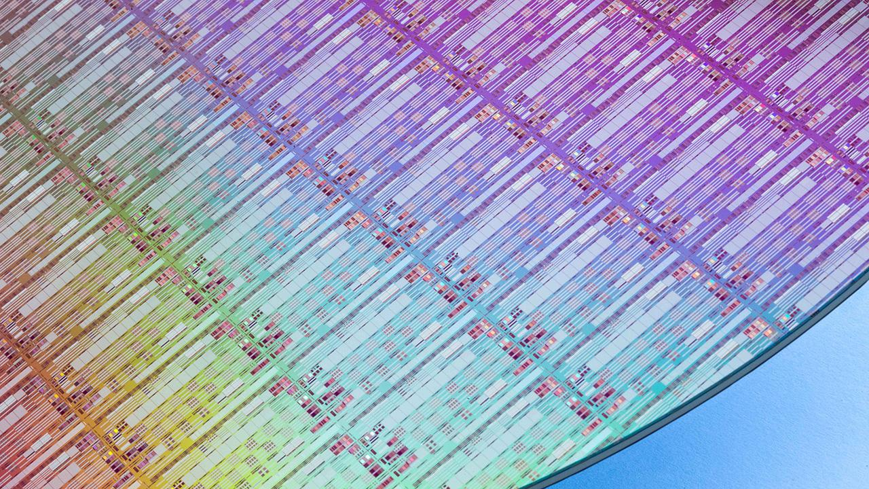
QEMU and Include OS overview
Dudi Likvornik
21.11.16

Slide 2

Source: xx

Slide 3
What is QEMU?
QEMU is two products in one:
An emulator (build around TCG – tiny code generator).
User space device emulation.
Limited hypervisor.
Works with linux hypervisor (KVM).
Source: xx

Slide 4
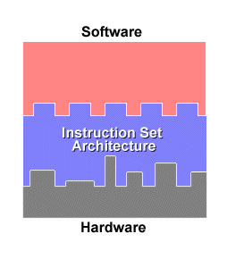
ISA
A program is compiled into a specific ISA (instruction set architecture).
An ISA is the interface between a software and an hardware.
Most known ISA in the world – IA32 (usually people call it 32bit x86).
Source: xx

Slide 5
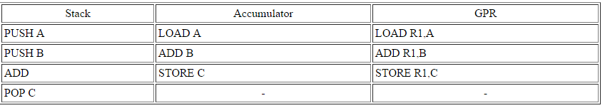
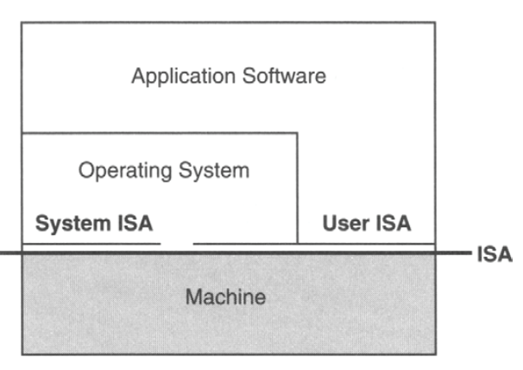
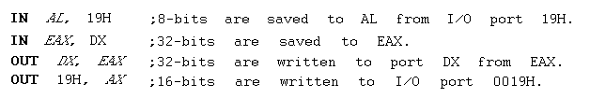
ISA
In reality an ISA is usually divided into two groups of commands, by privilege:
User ISA:
System ISA:
Hardware manipulation instructions:
Source: xx

Slide 6

Emulation
An emulator provides the mean to run a binary from source ISA on other Target ISA supported CPU.
The Target ISA might be the same or different.
For example – all mac applications written prior to 2006 were running on IBM processors, IBM uses the power pc RISC ISA. While most users wanting to run those application out side of mac computers were using IA32 CISC ISA. Emulators bridge the gap.
Two main approaches for emulation:
Interpreter.
Binary translation.
Who would prefer pc over mac?!
Source: xx

Slide 7
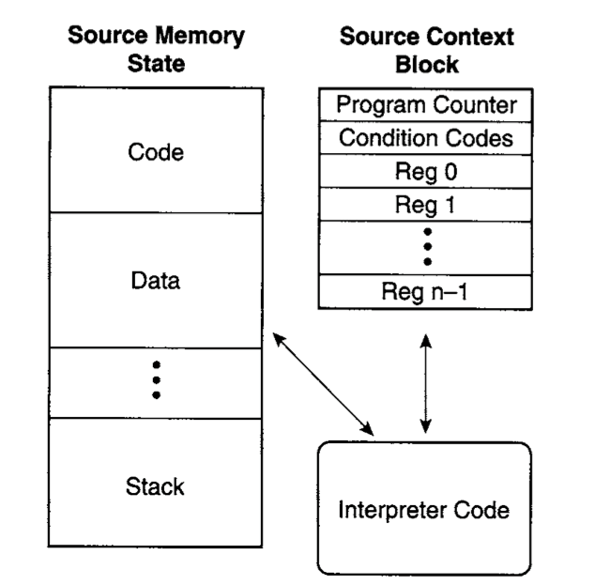
Emulation - Interpreter
Most naïve interpreter –
Source cpu state is managed in interpreter virtual memory space.
No use of registers directly, all is written in high level language (C in this case).
Many conditions In the main loop on the way to retrieve the right interpretation routine.
Each source cycle is paid in dozens and hundreds of target cycles.
Source: xx

Slide 8
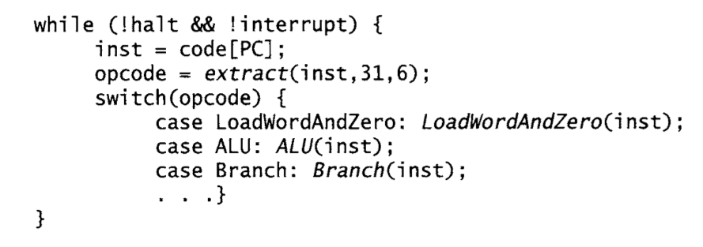
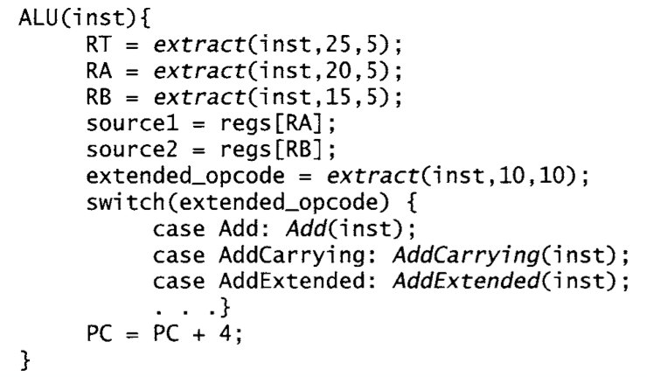
Emulation - Interpreter
Main loop
Main arithmetic handling routine
More specific instruction routine
Source: xx

Slide 9
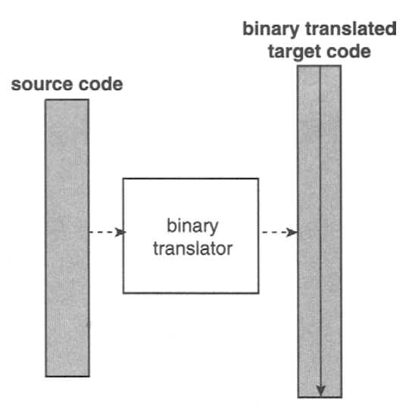
Emulation – Binary Translation
Most naïve Binary translation:
Contains a pre decode stage.
Translate all source ISA into target ISA.
Creates a second image in target ISA language with in process virtual memory space.
Executes the translated image.
We still holds a state of the guest machine
(PC register, status registers and ect…) all in main
Memory or mapped general registers.
Source: xx

Slide 10
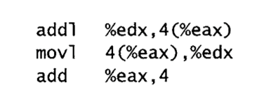
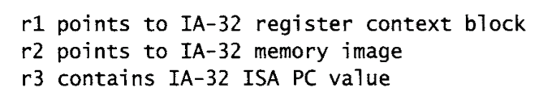
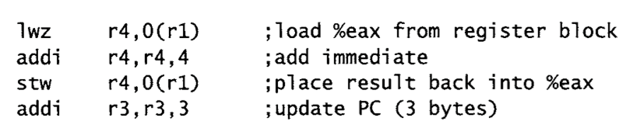
Emulation – Binary Translation
What about jmp instruction? Jmp works upon source ISA address, no use for us, our code is in Target ISA addresses. SPC VS TPC.
Source IA32 ISA
Add %eax, 4 command in target power pc
Instructions ISA
Source: xx

Slide 11
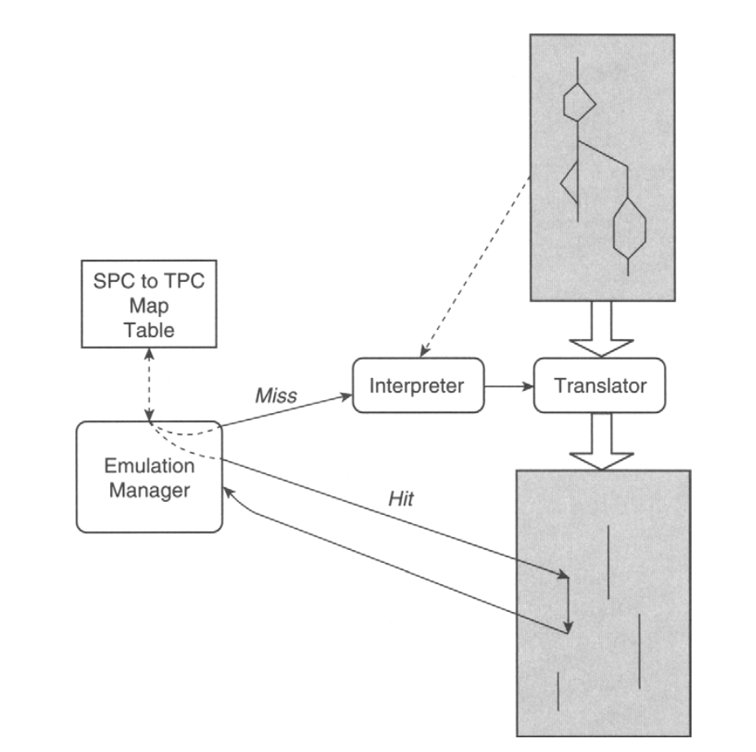
Emulation – Binary Translation
More legit solution for binary translation:
Lets have an emulation manager.
The manager holds an hash dictionary – mapping between source ISA virtual address to another virtual address.
The second virtual address points to block of translated target ISA,
ready for execution.
Source: xx

Slide 12
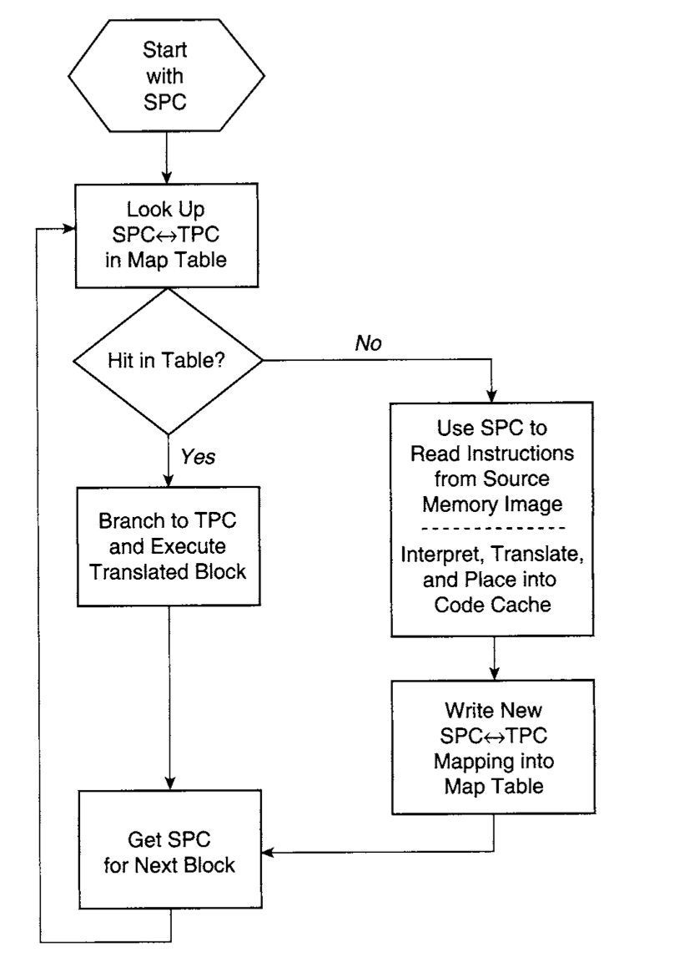
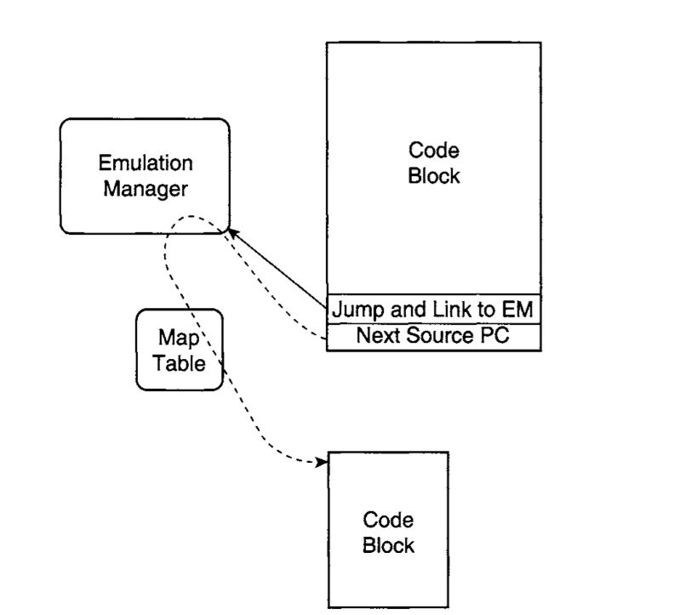
Emulation – Binary Translation
Source: xx

Slide 13
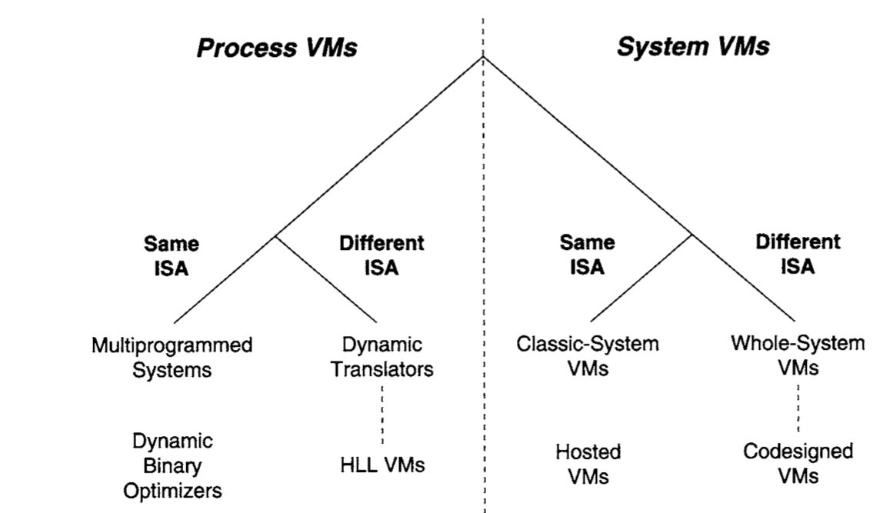
Virtual machines
What are virtual machines?
A program which provides the illusion of something. Happens around us daily, for example:
Most basic process virtual machine – virtual memory in paging system.
The process believes that his given memory is a real physical one, while it can actually can be swapped to the hardrive un aware by the OS.
Virtual machines are divided into two big groups – System and Process:
Process with virtual memory
Include OS
Java, CL
Source: xx

Slide 14
Virtual machines
Most virtual machines will run natively (on bare hardware) as a sole resources manager or partitioned – part in user space part in protected space.
image
Source: xx

Slide 15
Popek and Goldberg’s Theorem 1
Popek and Goldberg paper tried to apply a definition for virtual machine monitor.
The applied 3 rules:
Efficiency – All instruction will run natively on the hardware, with no emulation of the VMM.
Resource control – no guest will be able to change system resources applied to it (for example guest OS enlarging its associated physical RAM on its own).
all resources allocation will involve the VMM.
Equivalence – the Guest will behave the same way it would on native system (for example a swapped memory in the eye of a guest OS will not be in frame in reality).
Few exceptions – program may run slower due to monitor handling. Limit by known resource (physical resources are partitioned between several guests).
Source: xx

Slide 16
Popek and Goldberg’s Theorem 1 - Efficiency
Is Efficiency possible?
ISA is built out of privilege instructions and none privilege instructions.
The difference? When executing privilege instructions in user space they will resolve to trap.
For example: Load PSW instruction. This instruction loads the processor status word from location with in the memory.
The word contains the state of the CPU, for example a bit describing the current CPU privilege mode.
If a user mode program will use the given instruction from its controlled memory, it could change its privilege status on its own.
Any call for that instruction from user space will involve a trap and call for ISR from the kernel IDT.
Handling the given instruction is done natively – its sensitive and the Monitor will have the chance to handle it, for example zeroing out the privilege bit.
Source: xx

Slide 17
Popek and Goldberg’s Theorem 1 - Efficiency
So what we want (by instructions groups)?
Lets define two groups of instructions:
Sensitive – instructions that may manipulate the underline Monitor or hurt resource control.
None sensitive – all other instructions, we would like to run those natively on the CPU.
In order for the ISA to support an efficient VM all sensitive instructions needs to be privileged.
This is not the case usually, for example: pop stack into flag register (POPF) instruction.
According to intel IA32 ISA the instruction may run in none privilege mode (will overwrite all flags except interrupt enable flag). Their for the instruction in depended on mode of operation.
Since our OS will run in user mode, the wrong mode of operation will happen.
We see a case of none privilege sensitive instruction.
Source: xx

Slide 18
Virtual machines
Efficient ISA Vs reality:
So what is the solution?
The code needs patching. Problematic instructions needs to be replaced with correct response.
Will be done by using binary translation.
Source: xx

Slide 19

Source: xx

Slide 20
What is Include OS?
Include OS – is a unikernel.
What is a unikernel?
Single address space machine image (executable binary), composed of service (your product) and a library OS.
The OS is composed of the minimum requirements needed by the using service to run, such as specific resources:
Don’t need IP stack? Your OS shouldn’t provide any, mainly supporting drivers.
Source: xx

Slide 21
What is Include OS?
Include OS is a C++ library OS meant for unikernel solutions.
The library links statically to the selected service project/projects, composing a single binary with it.
Written in C++11, C and IA32 Assembly (mainly C++).
Source: xx

Slide 22
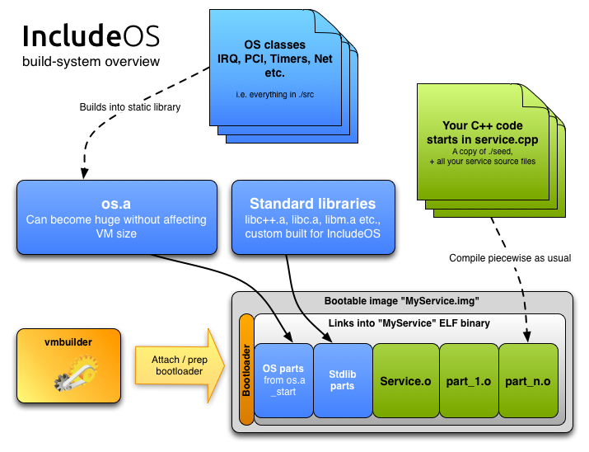
What is Include OS?
Source: xx

Slide 23
Include OS features
 | Features | Comment
Runtime Support | Fully supports ANSI C. | By Redhat Newlib
 | Fully Supports C++ (including 11). | By clang C++ lib
 | Exceptions.
 | RTTI.
Resources | Limited support of a selected collection of drivers, user chooses which. | Open for extension by user.
Environment | Single threaded.
 | Only physical memory space. | No virtual memory or paging.
Source: xx

Slide 24
Source: xx

Slide 25
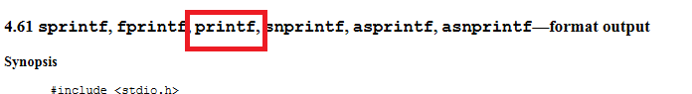
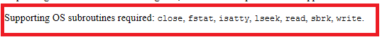
Lets build an OS, how was runtime support achieved?
NewLib – redhat portable, standalone ANSI C library project: https://sourceware.org/newlib/
A portable ANSI implementation written in C – No specific OS and ISA are needed.
Two main products – Libc.a, Libm.a (math).
Only requirement – OS needs to provide needed System calls, per runtime/standard routines collections:
Source: xx

Slide 26
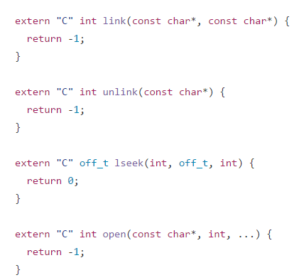
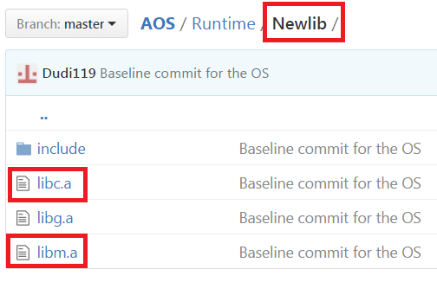
Meet Dudinka (Now AOS), a minimal OS
https://github.com/Dudi119/AOS
Required System call support (mangling in C):
Source: xx

Slide 27
AOS runtime propagation for syscall demo:
Source: xx

Slide 28
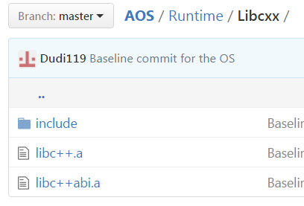
C++ support
Same idea as before, using clang C++ library:
Lets leave RTTI and Exception support alone for now.
Other requirements – for clang lib:
Built upon ANSI C (we did that!).
Some more system calls.
Source: xx

Slide 29
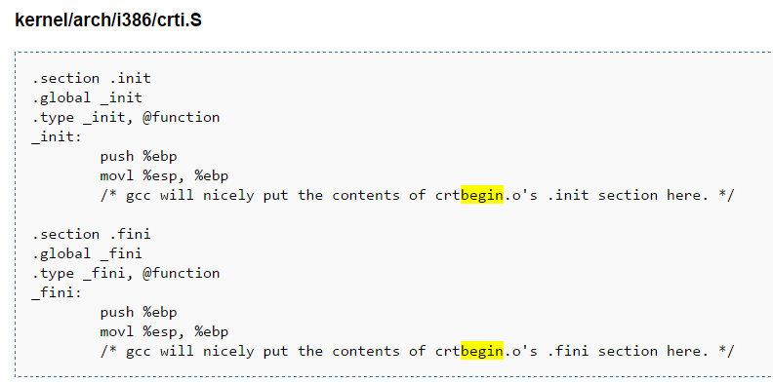
Compiler
Compilers provides a specific runtime support for a specific OS.
Build your compiler for a specific supported OS, it will bring the runtime library along.
It will also produce more code for tight to your OS (also runtime, but not implementation of your standard of language):
RTTI (if supported by the OS).
Exceptions (if supported by the OS).
initialization and termination lists (crtbegin and crtend) for static storage duration objects, called by OS _init and _fini functions prior for process start (_init) and after process termination (_fini). The linker will merge the compiler generated constructor and destructor code with the OS functions.
Stack protection.
Ect…
Source: xx

Slide 30
AOS Makefile:
32 bit
Intel 386 ISA
Which ABI
How rich is the language
Don’t bring (runtime lib) or generate code on the fly by any standard of C++ and C.
other runtime features are controlled using different flags – for example stack protection.
Source: xx

Slide 31
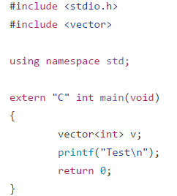
So lets summarized what we have until now:
Compiler supports only the basic of C++ - C with classes.
Missing runtime support – no global initialization, exception, rtti, any standard and ect…
We bring portable support for runtime and standard, both C and C++, yet limited.
Want to do this? It will work (only need to implement required sys calls).
You can see C standard (printf) and C++ standard (vector by STL).
Source: xx

Slide 32

So lets summarized what we have until now:
Now we are ready to start our OS, this is what happened in Include OS development.
Source: xx

Slide 33
Source: xx

Slide 34
Include OS - Memory
Topic |  | Comment
Address Mode | Works in 32 bit mode.
 | All addresses are linear. | Calculate next to segment base.
 | Flat memory model.
Segments | Granularity(Segment 1 size) set to 4k bytes.
 | Memory access properties/security and limitation is done via segments. | No support for Paging and Paging security.
 | 32 bit mode.
Bios memory | Overwritten partially by kernel stack.
Source: xx

Slide 35
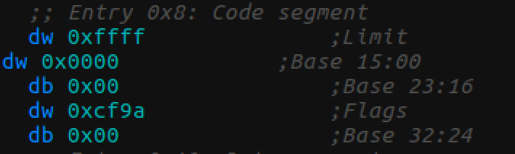
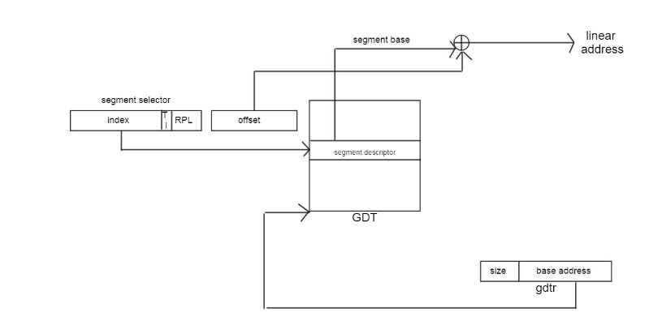
Segments and GDT
GDT set by customize bootloader.
Two entries – Data segment and Code segment, both identical.
SS (stack segment) entry is set to Data segment.
Work in 32 bit mode (full table in memory), Segment register just holds the entry address.
Segment limit granularity – 4k mode. Each segment is mapped to 4gb of physical RAM starting from address 0x00000000.
Source: xx

Slide 36
Include OS - Memory
Memory layout at the start of the OS:
Data/Code/Stack Segments
0x00000
Heap
Kernel stack
0x0A0000 – esp/Start of VGA memory
0x100000 – start of elf image
Multiboot
Text
init
Global constructors and destructors
fini
ctors
rodata
Exception support
eh_frame
data
end – start of heap
Source: xx

Slide 37
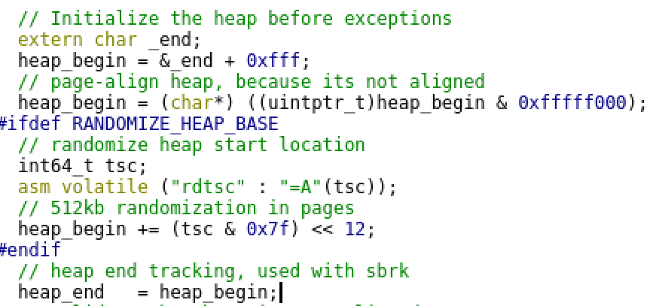
Using the heap
Heap is set by updating a boundary for the heap sector:
Heap is set at the end of the elf image, its start aligned for 4K.
Heap end is set, this is the moving boundary
Source: xx

Slide 38
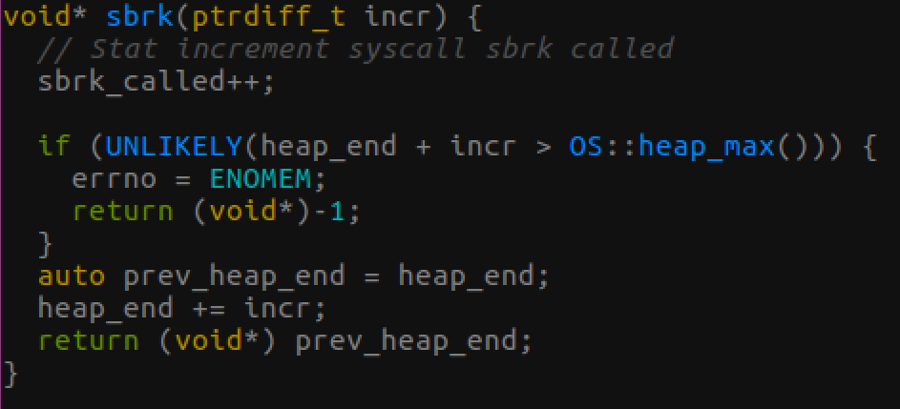
Memory management system call
Memory allocation is done via malloc runtime routine.
The malloc routine implements its allocator and is in charge on handling fragmentations.
Beneath all that lies the sbrk system call, in charge on enlarging the process provided memory.
In our system call, the heap_end (designating the end of the service memory) will move forward until the end of physical memory (no virutal memory support).
Source: xx

Slide 39
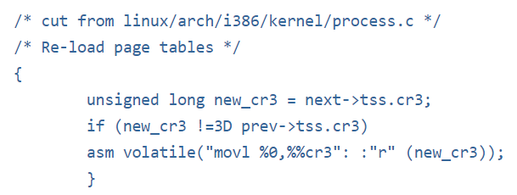
What are our benefits?
Since no virtual memory and paging exists:
No page protection fault may occur due to lazy addressing of virtual memory, what the allocator receives is valid by OS means.
No page fault, and IO payment due to swapping may occur.
No managing and flush of the TLB (MMU part).
All is simple.
We are better than linux :D, flush of tlb due to process
Context switch on linux.

Slide 40
Our loss?
No multi programing.
Protection is done via segments and not paging (resolution is much less better).
Caching is less efficient, no way to decide write through and write back in the granularity of page.
At the end we have a much simpler one service memory management system. Matching our top goal.
Source: xx

Slide 41
Advanced Configuration and Power Interface
Industry standard (Intel, Microsoft, Toshiba) for the OS to interact directly with the hardware.
Allowing the OS to:
Control the device power level
Set to sleep or standby un wanted hardware devices.
Allows the OS to monitor how many logical cores and local APICs.
Allows the OS to monitor how many external APIC.
Understand NUMA domains.
Query about external devices.
Many more.
Information about ACPI is stored in bios memory (first 1mb).
Wait, haven't we overwritten the bios memory with the kernel stack?
Only anything below 0xA0000, the base for ACPI data is between 0xE0000 – 0xfffff
We are safe!
Source: xx

Slide 42
ACPI descriptor tables
There are dozens of types of ACPI descriptor tables, each one handling other type of information or control over the hardware (memory mapped i/o).
IncludeOS is interested in only 2:
MADT - Multiple APIC Description Table, will contain information about which logical CPUs, external Interrupt controllers, IRQ info To detect devices???.
FACP - Fixed ACPI Description Table, provides control regarding power management.
Its being use to locate a specific control register to enable the shutdown of the entire computer on failure (under a selected system call).
FAPC Table
0xe0000
SDTHeader
SDTHeader
Real mode memory
MADT Table
FAPC address
SDTHeader
MADT address
RSDPDescriptor
0xFFFFF
Source: xx

Slide 43
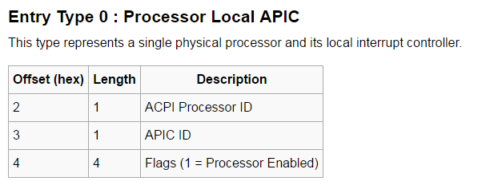
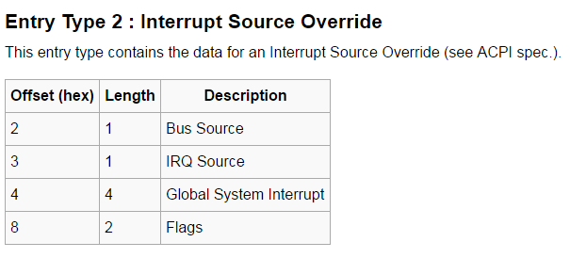
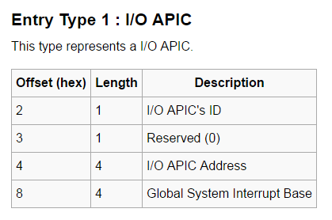
Advanced Configuration and Power Interface
MADT Table:
3 types of entries:
Source: xx

Slide 44
Advanced Configuration and Power Interface
ACPI class
lapics – vector of logical cores.
ioapics – vector of external APIC.
overrides – vector of existing IRQ lines.
Flow of discovery:
discover – finds RSDPDescriptor in real mode memory.
begin – finds sdt table.
Walk_sdts – parses the table, retrieving both MADT and FAPC table.
Source: xx

Slide 45
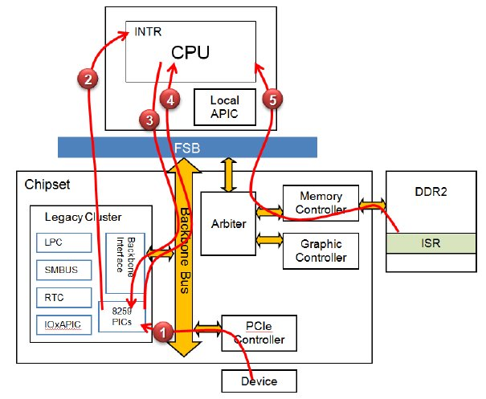
Legacy PIC – CPU interrupt schema
1) Device trigger IRQ line.
2) PIC decides to forward the request, notifies the CPU on none NMI interrupt.
3) CPU answer he’s willing to handle the interrupt.
4) PIC transfer vector index using the data bus.
5) CPU receives the index, preform interrupt switch (saving execution state), and calling the ISR matching the vector index from the IDT.
6) CPU report EOI to the PIC (missing).
7) CPU return to previous context for continue
Execution (missing).
Source: xx

Slide 46
Interrupts Handling
Managed by IRQ_manager class.
Class contains the idt (interrupt descriptor table, 32 bit mod version of IVT).
IDT contains 256 entries.
Each entry is 8 byte long, containing:
Physical linear address.
Segment selector.
Attributes.
Default interrupt parameters:
Work in 32 bit mode addresses.
Selector is set to code segment.
Source: xx

Slide 47
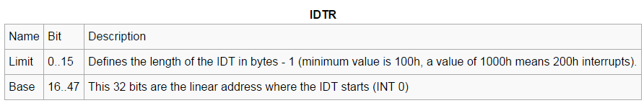
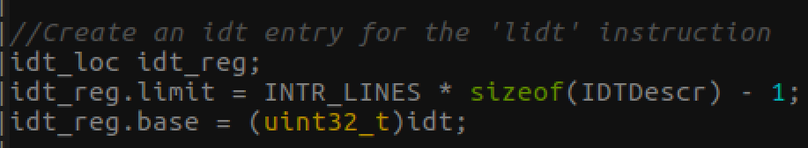
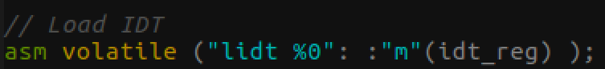
Setting the IDT table
Address of the idt is accessed by the CPU using the idt register.
Register Fields:
Setting the register:
Source: xx
Load idt command
From received argument (local variable)

Slide 48
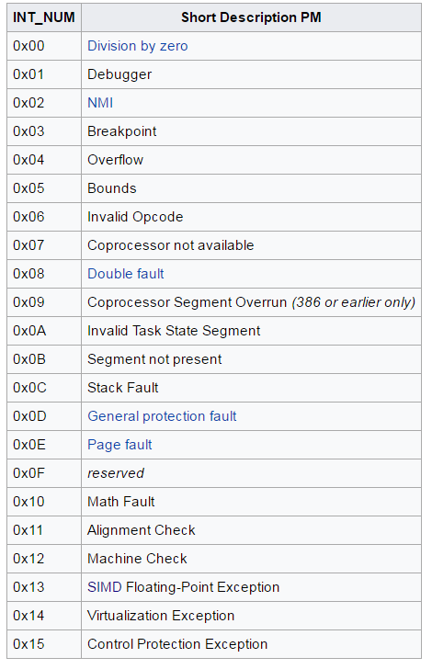
IDT registered services
0
Protected mode exceptions
Set to exception handling – panic message
31
32
Unused handlers –
{
1. pushes general registers
2. Call end of interrupt.
3. pop general registers.
}
Open for extension
254
Spurious Interrupt originates from external APIC???
255
Source: xx

Slide 49
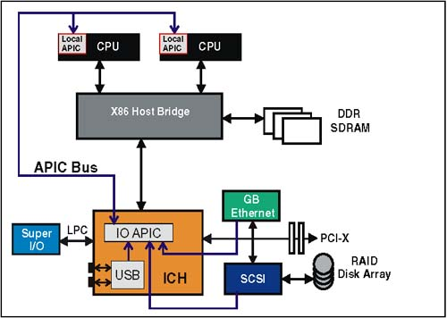
Advanced Programmable interrupt controller
Two hierarchies of Interrupt controllers:
Local APIC – in charge on triggering a specific CPU on all received interrupts:
Sits along side the CPU under its chip.
Support 3 kind of interrupts sources (not to confuse with types of trap/exception/HW interrupt/SW Interrupt):
Local – internal APIC timer, what ever is connected to pin L0/1, ect…
Out – originates from i/o device, retrieved from the APIC bus (since intel generation 6).
Inter CPU communication – retrieved from the APIC bus.
Work with Register space, mapped to physical addresses, working with those addresses will not initiate bus cycle (in paging, no frame should use those addresses due to this).
Source: xx

Slide 50
Advanced Programmable interrupt controller
Two hierarchies of Interrupt controllers:
I/O APIC – in charge on delivering to the interrupt information from i/o devices.
Sits on the chip set.
Controls I/O and peripheral devices.
Communicate with the Local APIC by using the AIPC bus (Virtual IRQ).
In the form of message.
Knows to address the request to a specific local AIPC.
(representing a specific core).
In basic PIC are in charge on:
Transforming IRQ to vector index
Routing the message to correct CPU (Or some starting point which will propagate using IPI messages).
Providing mask to interrupts.
Source: xx

Slide 51
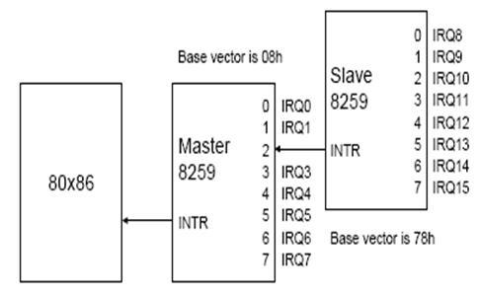
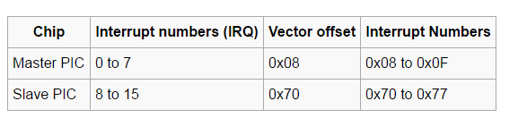
8259 PIC
Under real mode, only 8259 PIC is supported.
Intel legacy PIC:
A two cascaded 8259 PIC devices
(master is connected to slave by interrupt port 2).
Supports up to 15 interrupts, divided into two groups:
The OS IDT is built under protected mode, we already saw that interrupts – 0x00-0x15 are destined for exceptions and collide with the legacy PIC master internal configuration.
Two tasks upon the OS:
Disable the legacy PIC (done via masking).
Bring the newer Local and external AIPCs online, make sure their internal LDT are aligned to the OS IDT.
Source: xx

Slide 52
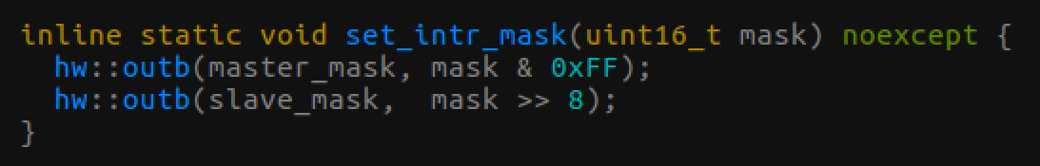
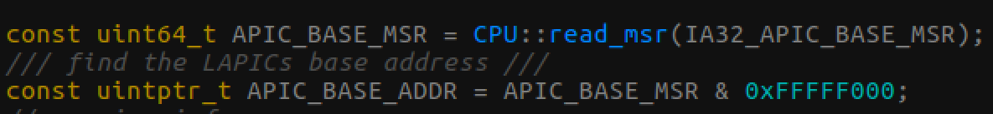
Legacy PIC settings
Disabling 8259 PIC master and slave interrupts (working in port io):
Configuring the local APIC:
Addressing the local APIC involves memory mapped io operation.
All storing will not involve bus cycles (done internally inside the CPU).
If the OS would have supported paging, no frame should have used the following physical addresses.
Retrieving the local pic base address using a specific MSR
Source: xx

Slide 53
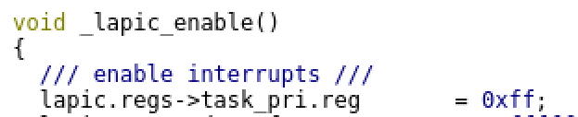
Local APIC settings
Configuring the local APIC:
Masking all external interrupts, needed class is set to >0xff, no such class (don’t want to be disturbed while configuring the APIC).
Building the LVT table of the APIC to match that of the IDT for handling local interrupts:
Interrupt | IDT vector index | Comment
LINT0 | 0x7B
LINT1 | 0x7C
Local APIC internal error | 0x7D
Local APIC spurious interrupt | 0x9F | Differ from regular malfunction pulse, in this case all the IRQs are virtual, due to that the only malfunction that may happen involves changing the masking by the CPU prior for sending the interrupt to the CPU.
Source: xx

Slide 54
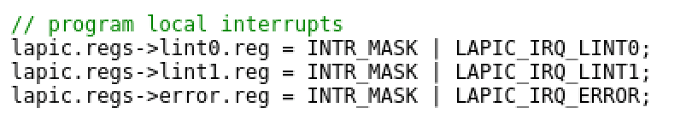
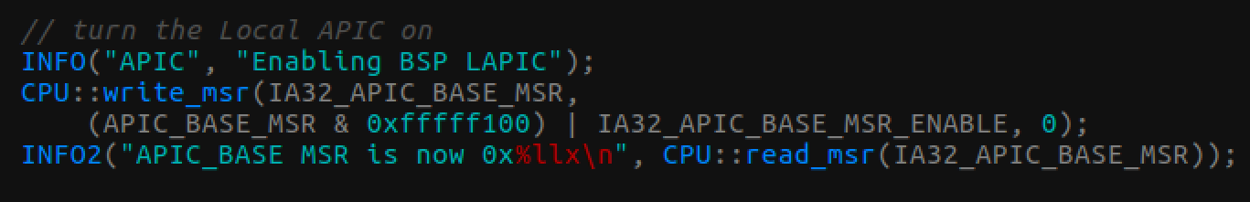
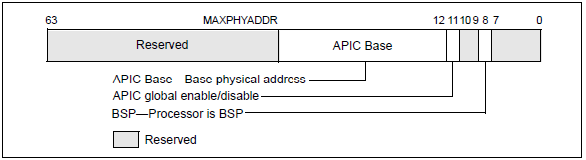
APIC setting
Configuring the local APIC:
Unmasking all interrupts at the local APIC, by that – allowing the PIC to deliver.
Turning on the local APIC:
Local APIC conclusion:
Turned on.
No masking of any sort, all interrupts may pass.
LVT is set.
Source: xx

Slide 55
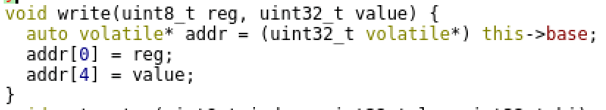
External APIC setting
Configuring the I/O APIC:
Access to IO APIC is controlled by two registers:
address - which internal register to interact with.
data – what data to write or read.
Writing to register involves:
Providing the target internal register address.
Reading the data on read or writing the needed data on write.
Address and Data registers are aligned to 32 bit.
Register | Register address
Address | Base + 0
Data | Base + 4
Source: xx

Slide 56
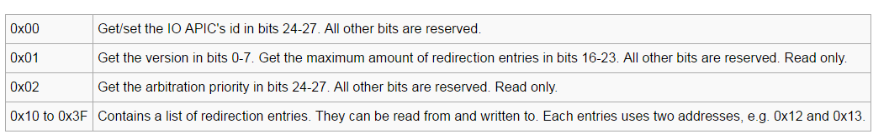
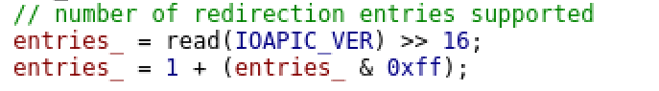
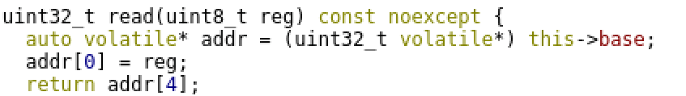
External APIC setting
External APIC register space:
Contains important information such as – redirection entries list (each entry represents a possible IRQ line).
For example we want to read the all entries:
First we want to know how many entries we have got, need to read the version register–0x01 (granularity of 32 bit), and shift the result to bit 16 (we don’t care about the version and the reserved zeroes):
Source: xx

Slide 57

External APIC setting
External APIC redirection list registers:
Controls of up to 24 IRQ lines.
24 entries in the list, each one 64 bit (each address represent 32 bit, so two addresses for each entry).
Selected fields of an entry:
Bit 0-7 – matching IDT vector index.
Bit 16 – interrupt mask.
Source: xx

Slide 58

External APIC setting
Include OS disables all interrupts (Didn’t decide yet which external IO it whishes to support), being done by setting bit 16 to 1.
Source: xx

Slide 59

Symmetric multi processing
Symmetric multi processing software and hardware architecture:
Multi core – all logical cores are identical by properties.
One shared physical RAM, viewed by all processes (unlike NUMA model).
All IO devices are shared with all processes.
One operating system controls all CPUs.
View them all as pool of resources.
Source: xx

Slide 60
Symmetric multi processing
MP platform boot sequence dictates the following:
Two types of logical processors:
Boot strap processor.
Application Processor.
At first only the Boot strap process will be active, doing the following:
Bios sequence.
Boot strap and diversion to protected mode.
Some of the OS boot sequence.
Applications processors will be brought up by the OS.
Source: xx

Slide 61
Symmetric multi processing
The OS knows about the existence of all other logical cores thanks to ACPI tables parsing.
Include OS wishes to bring each logical core to a specific state, and to maintain control over all logical cores (future support for multi threading?), in order to that it will need to:
Manipulate the logical core registers.
Setup the Local Pic of each logical Core.
The mean to communicate with each logical core is done via the IPI (inter processing interrupt) mechanism.
Source: xx

Slide 62
Booting sequence
Include OS contains a specific boot sequence for post booting for logical cores (Original booting code is the OS, SMP architecture mandate only a single OS instance).
Boot code is copied to real mode address space.
Application processors can only reach real mode
Address space of boot loader.
0x00000
Heap
Kernel stack
Boot code is copied to real mode address space, un reached yet stack location as of now.
2
2
0x100000 – start of elf image
Multiboot
Text
1
init
Original Location of the booting Code
fini
1
ctors
rodata
eh_frame
data
end – start of heap
Source: xx

Slide 63

SMP Booting sequence
copying the booting code:
Calculate the booting code size and starting address according to pre placed symbols at the start and end of it.
Copy the boot code to 0x80000
Source: xx

Slide 64

SMP Booting sequence
Building a new global IDT.
In SMP only a single IDT should be available.
Since Include OS is single explicit logical core OS, the other cores will work with stub IDT.
Support exception + local interrupts only.
No external will be directed to the other logical cores (logical addressing is used by the external APIC).
All handlers will be default ones.
Allocating a new IDT some where in the heap.
Filling exceptions.
Filling local interrupts.
Source: xx

Slide 65


SMP Booting sequence
A unique Stack is needed per logical core, since we are going to run a procedural code.
How is possible to provide a unique stack for each core? a trick is used:
Booting code contain 12 bytes at the start of it:
The code was moved from the text segment to the kernel stack due to the fact, those 12 bytes are going to be written (now assigned to 0 by the compiler) and text section is read only area in theory (not in our case due to overlap segments).
Allocating a new stack on the heap and overwriting the above 12 bytes:
Boot code business logic.
Allocating continuous memory for all logical cores stacks as a whole
Source: xx

Slide 66

SMP Booting sequence
The process of initializing the other logical cores is divided into two parts:
Setting the memory for the initialization:
Moving the boot code.
Allocating the stack.
Ect…
Initiating the initialization using the local APIC.
A barrier is placed in the middle in order to make sure, all memory is set prior of initiating the command.
Setting the memory
Initiating
Source: xx

Slide 67



SMP Booting sequence
The barrier is also used as a spinning lock mechanism:
in order to synchronize the wait for all the other logical core state initialization.
The barrier is first initialize to 1 (current logical core is up to state):
It will then spin wait for the completion of all the other logical cores:
Also placing a fence (all inspection will only occur once all init messages were sent).
Source: xx

Slide 68

SMP Booting sequence
Increment is done once at each logical core, once its needed state was set, this is done via a special builtin atomic operation support the compiler provides.
Source: xx

Slide 69

SMP Booting sequence
In order to initialize all the other logical cores, the local pic will be used.
Local pic support – Inter processing interrupts (act as messaging mechanism between different logical cores).
Issuing an IPI is done via the APIC interrupt control register (ICR).
Logical id of the destination local APIC, according to the destination protocol.
What are we going to produce for the destination processor: for example – interrupt.
No shorthand – use the destination described in the destination field.
Read only status, indicating if the APIC sent its last request or doing nothing.
Source: xx

Slide 70

SMP Booting sequence
IncludeOS is going to trig a virtual IRQ against all other local APIC from the current logical core local APIC:
Vector 0x00 value interrupt will cause
A reset at current un responsive
Application processors.
Each newly initialized core will do the following:
Will run a minimum bios code.
Will end up in real mode with the capability to receive interrupts and on halt.
The code to initiate a single logical core.
Vector == 0x0
Sending an interrupt to a selected Local APIC (designated by the logical ID)
Polling the APIC by reading its status work, until sending the interrupt is done.
Source: xx

Slide 71
SMP Booting sequence
Increment is done once at each logical core, once its needed state was set, this is done via a special builtin atomic operation support the compiler provides.
Source: xx

Slide 72
Security – Heap memory
Heap start memory is randomized:
Source: xx

Slide 73
Security – Stack overflow protection
Source: xx

